Slide 1
Customer Retention Project
Report by :
Pratiksha Potghan
Internship 30
Flip Robo Technology

Slide 2
What is Customer Retention?
Customer retention is a business’s ability to keep existing customers and continue to generate revenue from them.
Companies use different tactics to convert first-time buyers into repeat shoppers. In other words, customer retention allows a business to increase the profitability of an existing customer and maximize their lifetime value (LTV).

Slide 3
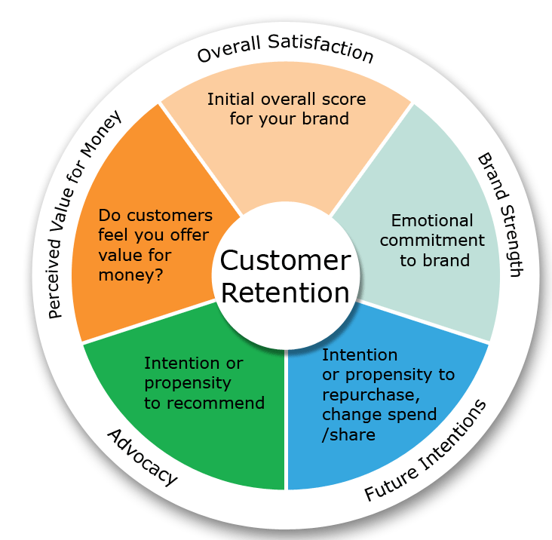

Slide 4
Why Is Customer Retention Important?
Customer retention is vital in driving repeat purchases and ongoing value from your customer base.
One oft-cited rule of thumb is that it costs five times as much to acquire a new customer as it does to retain an existing customer.
Two of the most important factors in improving customer retention is understanding your customers’ satisfaction and loyalty.
Businesses also need to understand any operations that may turn off potential and existing customers, such as slow or poor customer service or a faulty product.

Slide 5
Customer Acquisition vs. Customer Retention
Customer acquisition refers to the actions or processes designed to help a business gain new customer. This includes any efforts focused on finding new leads or turning prospects into paying customers.
Customer retention, on the other hand, happens after you acquire the customer. Once they make a purchase, you’re trying to build loyalty and drive repeat business.

Slide 6
Benefits of Customer Retention
The main benefit of customer retention is the ability to maximize the amount of money you can extract from each customer. There are also other benefits including the following:
Increased profits:
Many companies generate the majority of their revenue from existing customers—61% of SMBs said this was the case, per a BIA/Kelsey report—so focusing on this part of your business should be the priority. It will not only increase your revenue, but also your business’s profitability.

Slide 7
Lower costs:
Retaining an existing customer is anywhere from 5-25 times cheaper than acquiring a new one, according to Bain & Company, so it’s a much more cost-effective strategy in the long run.
Increased average order value (AOV):
Repeat customers tend to spend more over time while increasing their average order value. That’s why just a 5% increase in retention rate can lead to profits growing 25-95%, per Bain & Company. And loyal customers are 23% more likely to buy again than others, according to a Gallup study.
Acquire brand ambassadors:
Word of mouth is one of the best ways to grow your business organically. The more loyal your customers, the more likely that they’ll share positive experiences and recommend your company to others.

Slide 8
Customer Retention Statistics
Poor customer service would convince 39% of people never to use a company again and 37% to change suppliers, according to research from New Voice Media.
Temkin Group found that 77% of customers would recommend a business to a friend after having just one positive experience.
It takes 12 positive customer experiences to make up for one negative experience, according to Ruby Newell-Legner’s “Understanding Customers.”

Slide 9
5 Strategies to Improve Customer Retention
Engage with customers:
Look at your marketing channels and identify the best ways to engage with your clients. Do they respond best to social media, email marketing, online events or something else? Let customers weigh in on upcoming products and services, so they feel like they’re part of the brand.
Reduce friction in the purchase process:
The fewer obstacles or challenges customers face when purchasing your product or service, the better. When it comes to ecommerce, fast page load times and a fast, simple checkout experience is critical. In a store, eliminate friction by making sure a staff member is always available to help a customer when they’re ready to check out.

Slide 10
Improve customer support:
Offer multiple ways for customers to reach you. This can include live chat on your website, a dedicated telephone number, email, social media and a comprehensive FAQ page online. Additionally, you want to ensure fast response rates. Training your staff well and measuring their performance with benchmarks will help you meet customer expectations for communication.
Create a community:
Having exclusive membership programs or forums where your company representatives and customers can interact with each other will help generate more brand loyalty and buzz. Other ideas include giving discount codes to loyal customers and creating referral programs that offer current clients an incentive.
Start a loyalty program:
Loyalty programs can be a great way to motivate existing customers to make additional purchases and at a higher frequency. Ensure that your loyalty program has rewards that existing customers would find valuable, like free products or significant discounts.

Slide 11
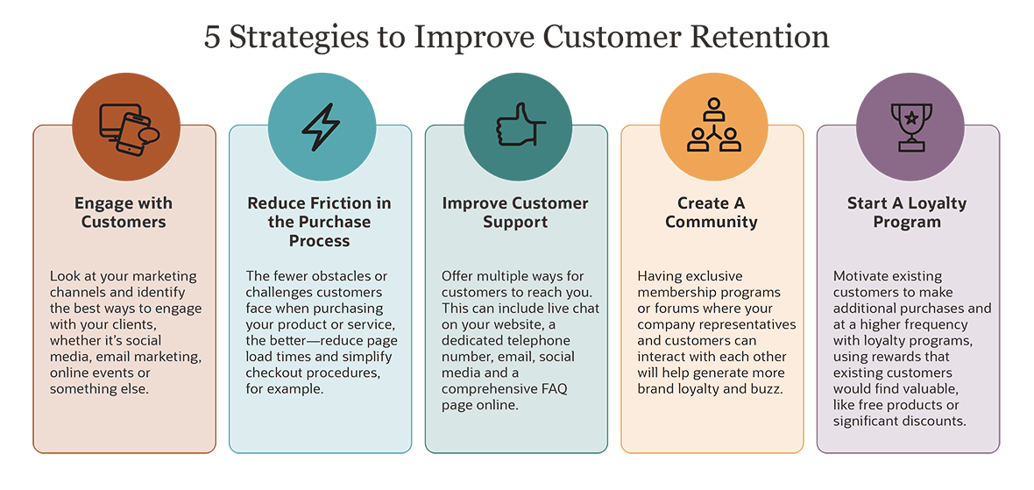

Slide 12
Customer retention metrics
Here are the 3 most important and widely utilized metrics:
Customer retention rate (CRR): The percentage of customers retained over a period of time. Though a 100% customer retention rate is ideal, it varies across industries. Regardless of the industry, modify your strategy if your CRR hovers around 15%. [3]
Customer churn rate (CCR): This is the percentage of customers lost over a period of time. Companies with a low customer churn rate tend to have a higher CRR, so the closer the CCR is to 0%, the better.
Customer lifetime value (LTV): This is the projected revenue from a customer throughout the purchasing lifecycle. It helps businesses measure customer loyalty. LTV also identifies ways to maximize the return on investment (ROI) for product marketing and support team development.

Slide 13
Customer retention, CX, and CRM
Customer experience (CX) and customer relationship management (CRM) systems are significant components of the customer retention process.
A CRM system unites multiple functions (e.g. project management, contact management, digital marketing) into a single data-driven platform. A “unified” CRM system automates communications and streamlines internal processes to enhance the overall CX. It may include “hyperpersonalization” features (e.g. targeted content, offers, alerts) that silo customer engagement within a specific context.
Overall, a unified CRM provides procedural consistency and reliable data that help increase customer retention and company revenue.

Slide 14
Customer retention best practices
Net Dollar Retention (NDR) is a churn metric that calculates the percentage of recurring revenue retained from existing customers over a period of time. Since NDR considers multiple factors (e.g. downgrades, cancellations, pause requests) that impact recurring revenue, it is the best indicator of customer retention success (versus Monthly Recurring Revenue (MRR) and Annual Run Rate (ARR)).

Slide 15
These five best practices are designed to drive NDR rates toward customer retention success
Value-based selling: This is a consultative approach that prioritizes customer value during the purchasing process. It prioritizes needs and enables customers to make well-informed purchasing decisions. This increases brand sentiment, which establishes brand loyalty.
Drive product adoption & expansion: A positive product experience (PX) helps drive a successful CX. Adoption and expansion are the fruit of resolving customer needs, challenges or pain points. This increases brand trust and sentiment as well as customer loyalty.
Accelerate time to value: Assess customers’ needs throughout the onboarding process to sharpen resolutions. Synchronize their requirements with product and service features so customers can make swift purchasing decisions and quickly allocate resources.
Align with customer needs: Use a roadmap to synchronize products and services with customer needs. Include customer research to gain insights and guide efforts toward providing customer satisfaction, which builds brand trust.
Manage customer engagement: Use a high-touch engagement model to optimize live interactions and build customer rapport. This creates high-level engagement that drives customer success, which builds brand sentiment and trust.

Slide 16
Online Retailers Preferred

Slide 17
Who is our potential customer?
21 – 50 Years are potential age who covers - 85% sales
Females are the Potential customer - 67.29%

Slide 18
Top 10 Cities for e-commerce

Slide 19
Shopping Pattern
Since how long you are shopping online?

Slide 20
How many times you have made an online purchase in the past 1 year?

Slide 21
How customers do shopping?

Slide 22
How Customer reached to online website?

Slide 23
Customer habit on ecommerce

Slide 24
Website content

Slide 25
Which of the Indian online retailer would you recommend to a friend?

Slide 26
Performance during promotion, sales period

Slide 27
Platform Technical performance
Reliability of the website
or application
Conclusion:
Amazon is technically best platform as per customer choices
Flipkart is on the 2nd position in this category
Paytm secured 3rd position on platform stability
Myntra is on 4th position
Snapdeal is on 5th position

Slide 28
Conclusion
Customer retention do not improve overnight.
First, know your customers. Figure out what they want and need.
Next, find ways to surprise, delight, and motivate them.
Get in touch. Ask for feedback and testimonials.
Help them realize you appreciate their patronage.
Using tools like crazy Egg, you can test every strategy you try and continuously refine your approach. The more you test, the stronger your customer retention program becomes.

